Slide 1
Capstone Project - 4
NETFLIX MOVIES AND TV SHOWS CLUSTERING
BY RUSHIKESH ARJUN MANE (Cohort Seattle)

Slide 2
Contain
Introduction
Dataset Preview
EDA ( Exploratory Data Analysis )
Data Preprocessing
Creating Clusters
Conclusion

Slide 3

Introduction
NETFLIX is a media distribution company its stared with DVD distribution via mail but has evolved substantially over the course of its existence.
NETFLIX works on a subscription model, where users get unlimited access to content with a paid subscription and NETFLIX had approx. 220.67 million subscribers worldwide in 2022.
NETFLIX began experimenting with data since 2006 when they attempted to predict how much a viewer would like a movie based on existing preferences.
The NETFLIX Recommendation Engine’s precise recommendations account for 80% of the Netflix viewer activity.
Clustering plays a significant role in building recommendation engines helping group similar content and similar users together to predict user preferences accordingly.

Slide 4
Dataset Preview
Attribute Information
show_id : Unique ID for every Movie / Tv Show
type : Identiﬁer - A Movie or TV Show
title : Title of the Movie / Tv Show
director : Director of the Movie
cast : Actors involved in the movie / show
country : Country where the movie / show was produced
date_added : Date it was added on Netﬂix
release_year : Actual Release year of the movie / show
rating : TV Rating of the movie / show
duration : Total Duration - in minutes or number of seasons
listed_in : Genre
description: The Summary description

Slide 5
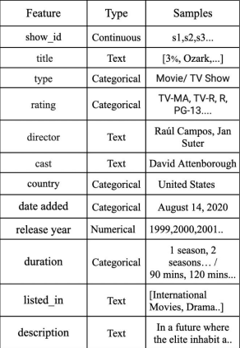
Dataset Summary
NETFLIX content dataset contains data of7,787 video content listed on the platform collected from Flexible, a third-party Netflix search engine.
The dataset contains 12 attributes and 7787 rows.
Attributes providing video details about the video cast, director, duration and countries the content was produced in.
Attributes also provides site details like signing date, listed description and topics the content is being listed under

Slide 6
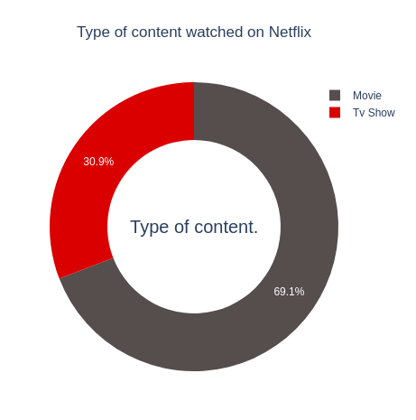
Exploratory Data Analysis (EDA)
69.1% of content available on NETFLIX are movies and remaining 30.9 % are the TV shows.

Slide 7
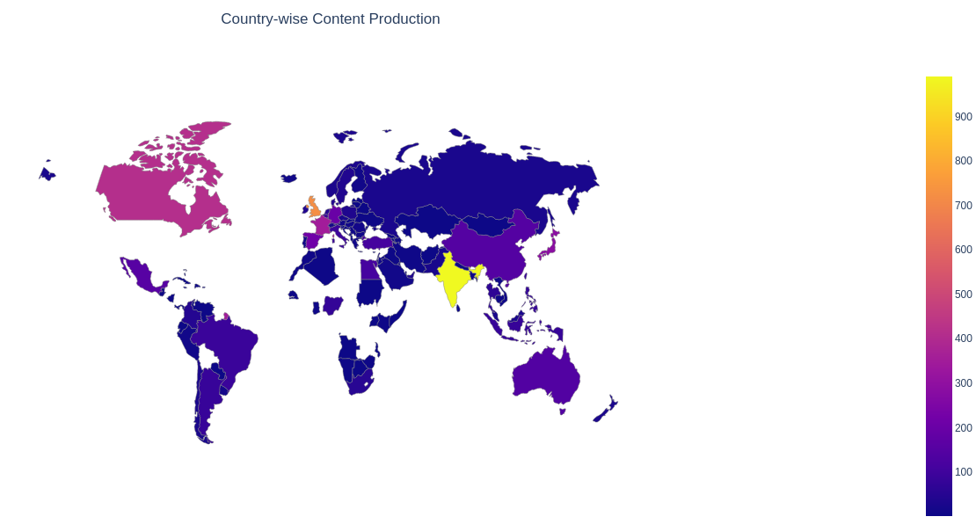
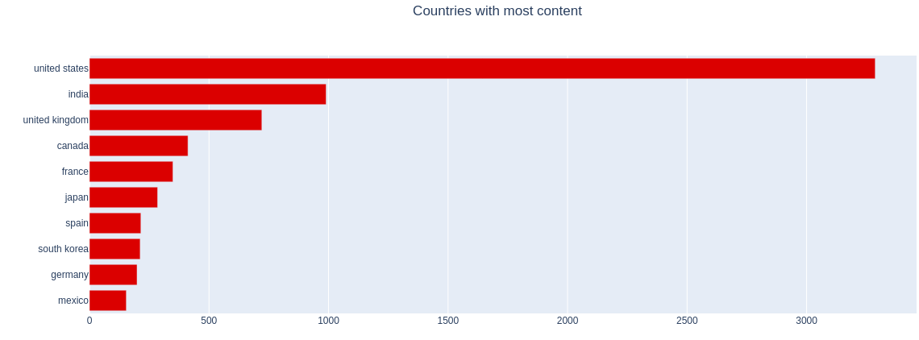
We can see that only 10 countries contributes major of the content available on NETFLIX.
USA, INDIA and UK are the top 3 countries which produce more than half of the movies and TV shows.

Slide 8
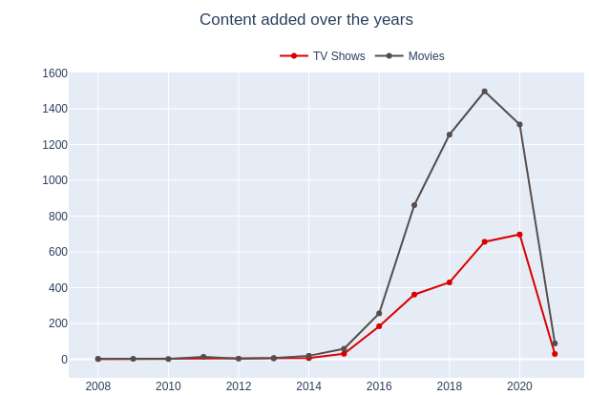
From 2015 we can see NETFLIX expands its content library rapidly.
Growth in the number of movies is so much higher than TV shows.
2019 and 2020 years NETFLIX added its major content.
In 2021 very few movies are added or due to no enough data we can’t predict that much.

Slide 9
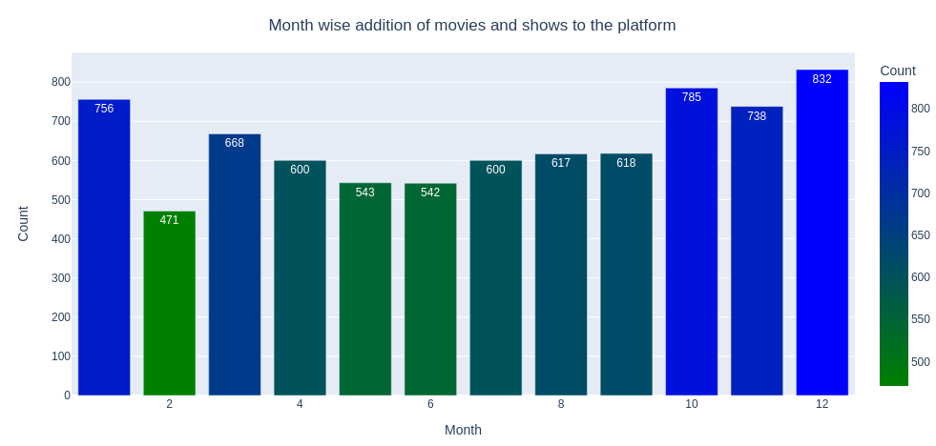
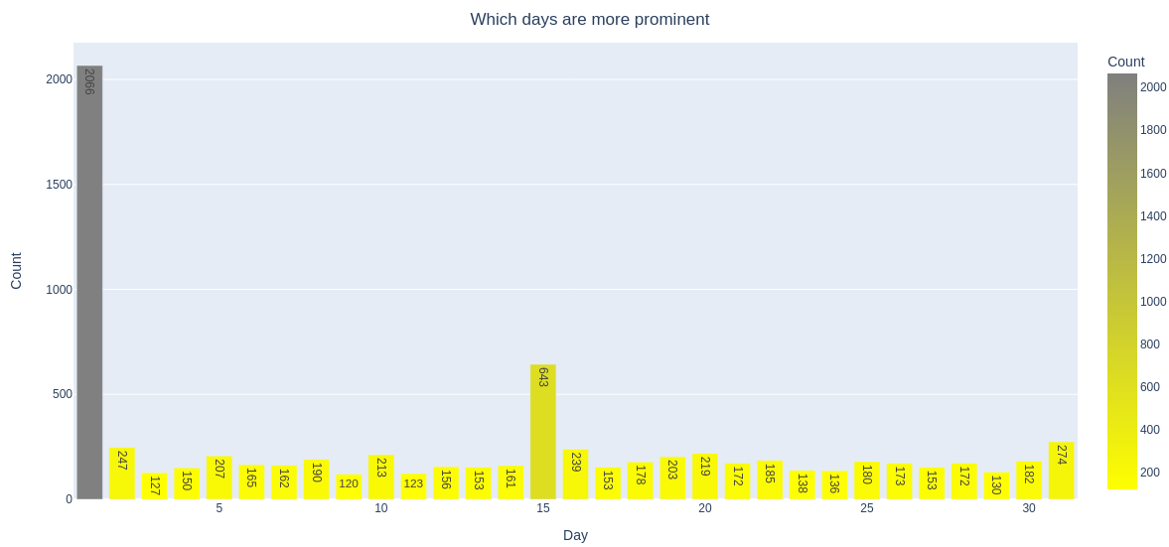
NETFLIX uploads most of the content either on ending and beginning of month.
1st , 15th and 31st are the prominent days for uploading new content on NETFLIX.
October, November, December and January are month in which many shows and movies get uploaded to the NETFLIX.
It might be due to the winter, as in these months people may stay at home and watch shows and movies in their free time.

Slide 10
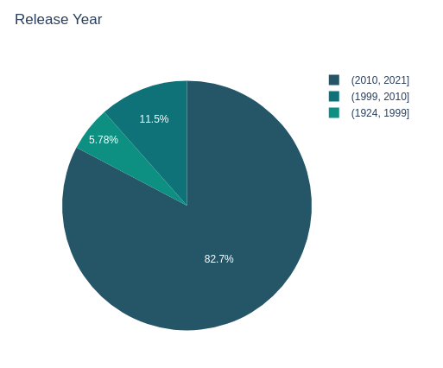
Major content upladed on the NETFLIX in the year 2010 to 2021 i.e. 82 %.

Slide 11
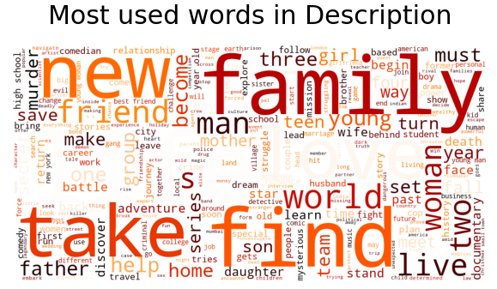
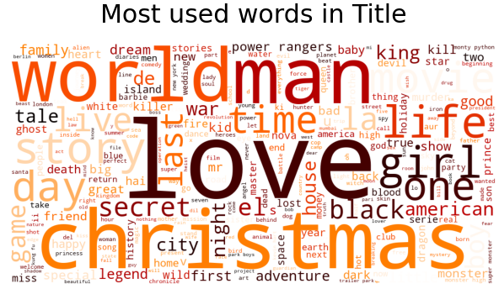
Christmas, Love, World, Man and Life etc. are the most repeated words used in titles.
We saw that most of the movies and TV shows got added during the winters, which tells why Christmas appeared many times in the title.
In description of TV shows and movies Family, Friend, Love, Life, Women and Man are most commonly used words.

Slide 12
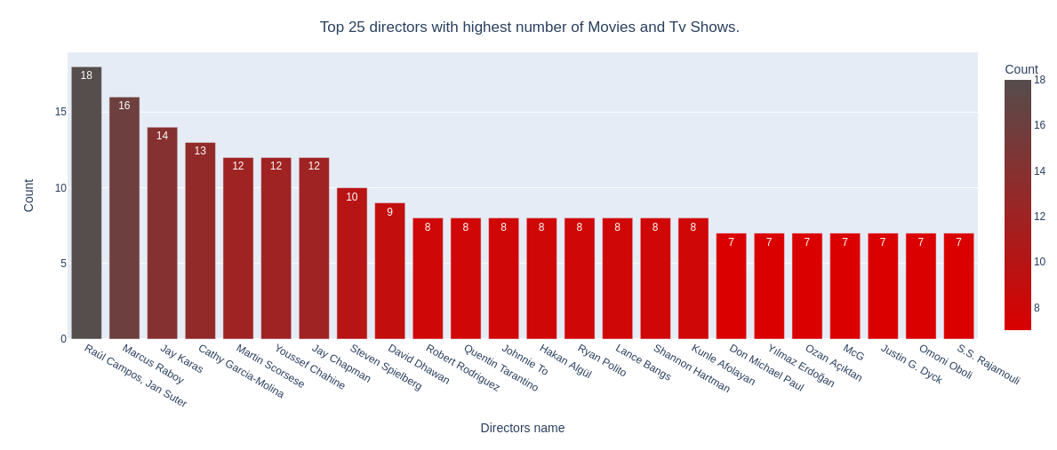
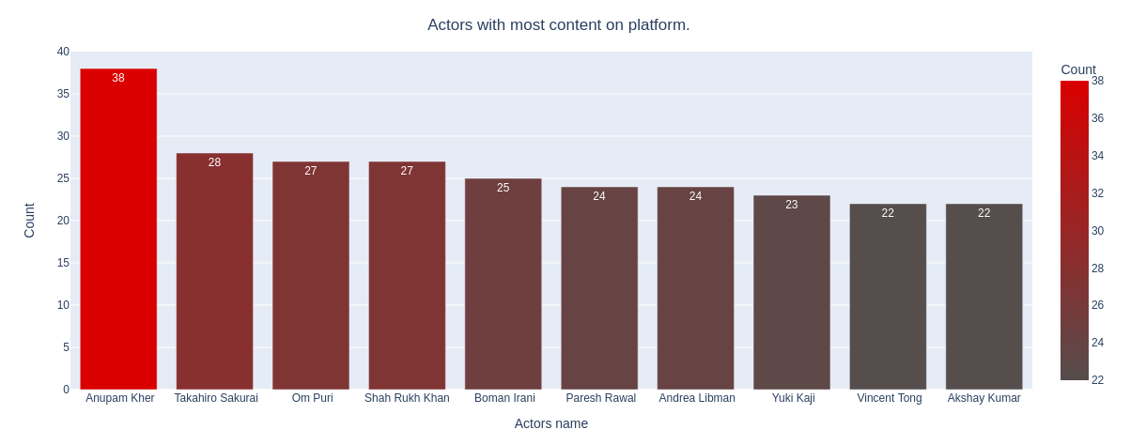
Raúl Campos, Jan Suter, Marcus Raboy, Jay Karas, Cathy Garcia-Molina, Jay Chapman are the top 5 directors which highest number of movies and tv shows.
Top six actors form the movies and TV shows are Indian.
Anupam Kher at the top with 38 TV shows and Movie in total.

Slide 13
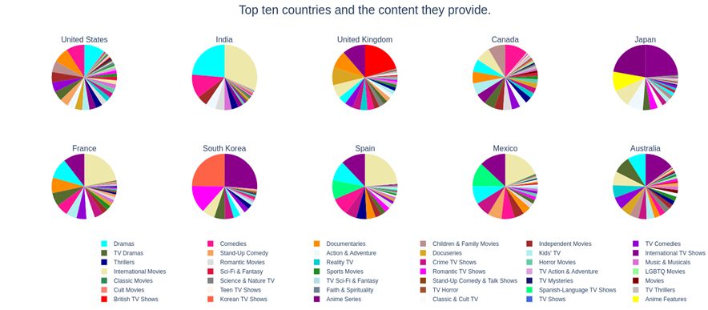
Most popular choices in different countries are Drama, International Movies and Comedies.
Regional specialties such as Anime in Japan and Korean Tv shows in South Korea are more prominent in these countries; This makes sense as anime has always been popular in Japan, and the rising k-pop culture explains the increase in Korean Tv Shows.
In UK British and International TV shows dominate the market.
We can also see that the English language content are very common in non English speaking countries.

Slide 14
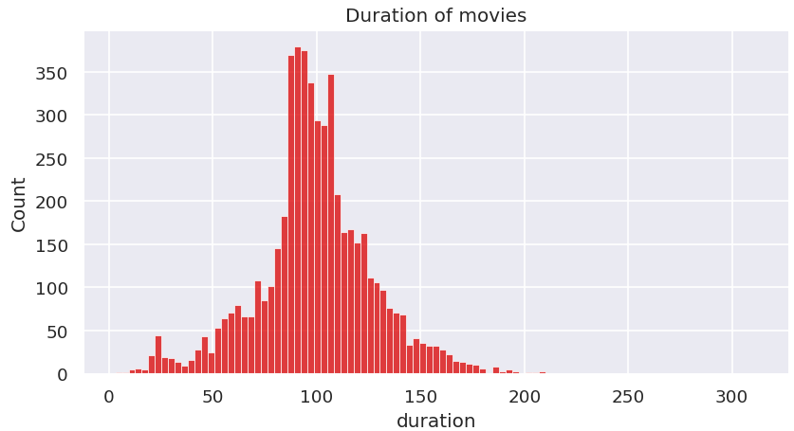
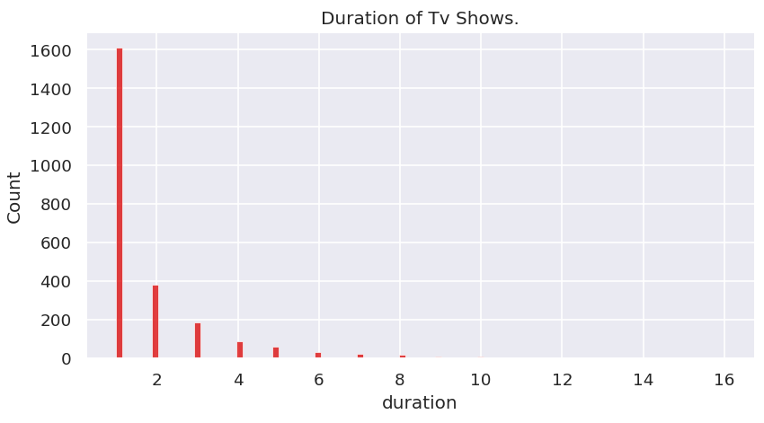
Duration of Movies are mostly between 90 to 120.
Most of the TV shows last for 1 or 2 seasons, it is rare for a show to have more than 5 season.

Slide 15
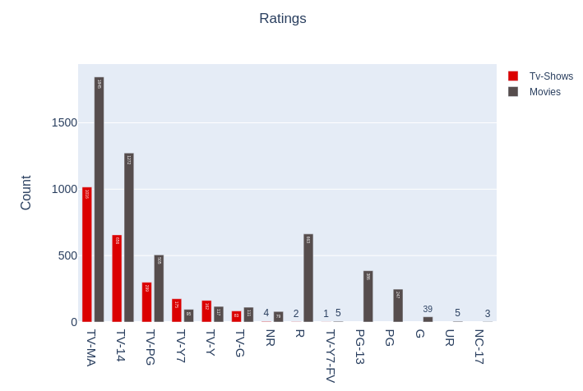
TV-MA tops the charts, indicating that mature content is more popular on NETFLIX.
This popularity is followed by TV-14 and TV-PG, which are shows focused on Teens and Older kids.
Very few content with a rating NC-17 exist. It can be understood since this type of content purely for the audience above 17 years old.

Slide 16
Data Cleaning
There also exist some null values in our data:
Percentage of null values in director : 30.68%
Percentage of null values in cast : 9.22%
Percentage of null values in country : 6.51%
Percentage of null values in date_added : 0.13%
Percentage of null values in rating : 0.089%
Since there are very few null values in date_added and rating we will drop them.
Finally we will do some feature engineering to create few new variables: Compute year_added, month_added and day_added from date_added after converting it into datetime variable.

Slide 17
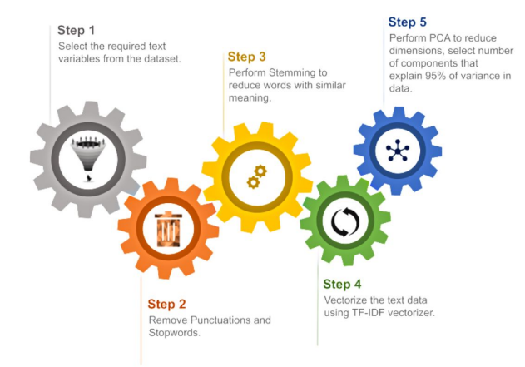
Data Preprocessing:

Slide 18
Creating Clusters
What is Clustering ? 🤔
Clustering is the task of dividing the data points into a number of groups such that data points in the same groups are more similar to other data points in the same group and dissimilar to the data points in other groups. It is basically a collection of objects on the basis of similarity and dissimilarity between them.
How to cluster similar data?
To create clusters we will use the K-Means Clustering; which is an iterative process in which the dataset is grouped into k number of predefined non-overlapping clusters or subgroups, making the inner points of the cluster as similar as possible while trying to keep the clusters at distinct space it allocates the data points to a cluster so that the sum of the squared distance between the clusters centroid and the data point is at a minimum.

Slide 19
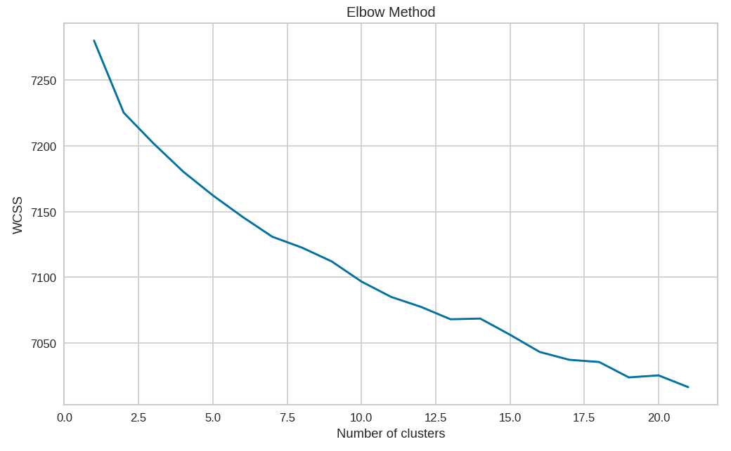
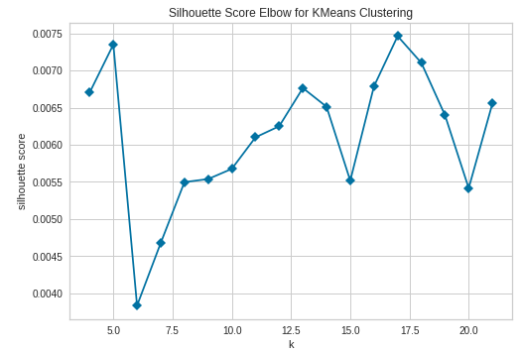
Determining optimal value for k
Using the silhouette Score and Elbow Method we select the optimal number of clusters to 10.

Slide 20
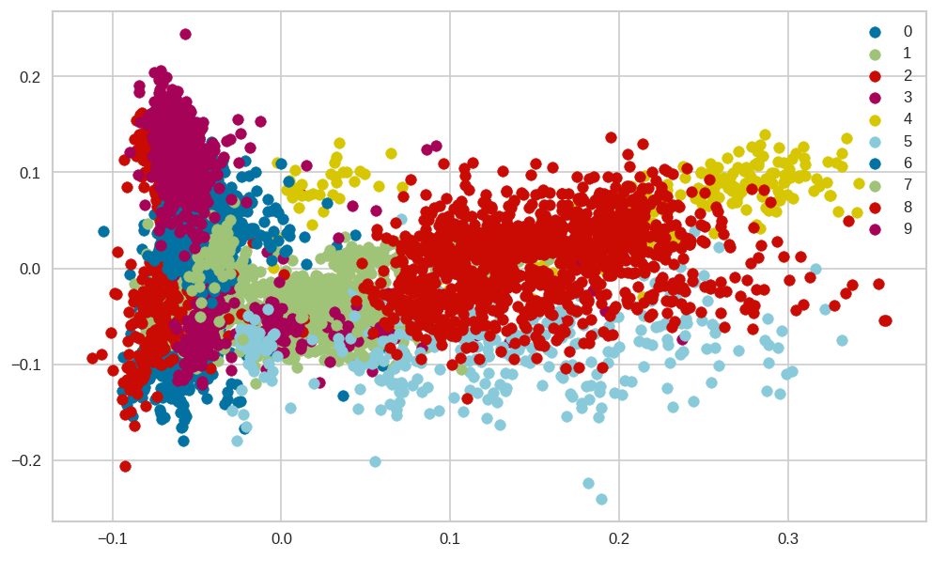
The numbers 0 and 9 represent 10 distinct cluster formed by K-means clustering.
Each cluster contains data point similar to those in the same groups but varies form other groups.

Slide 21
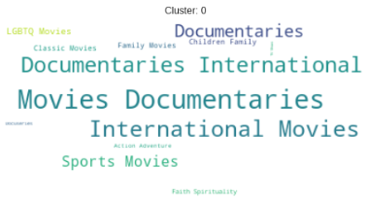
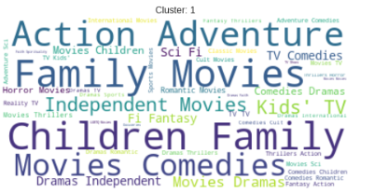
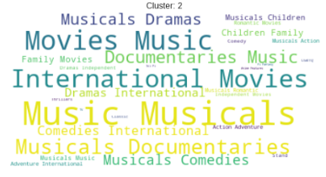
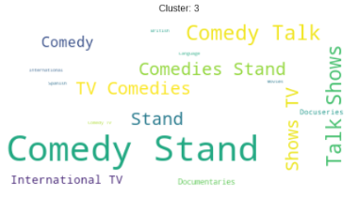
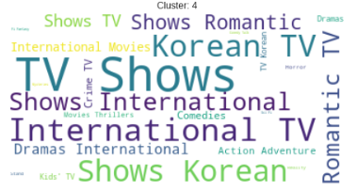
Data represented by each cluster
Cluster 0: Documentaries.
Cluster 1: Family and Children Movies.
Cluster 2: Musical Movies and Documentaries.
Cluster 3: Stand Up Comedy and Comedy Shows.
Cluster 4: Korean and Romantic Tv Shows.

Slide 22
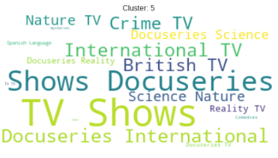
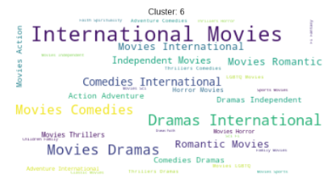
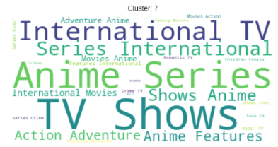
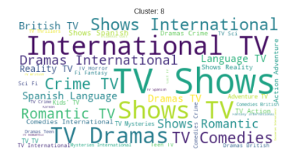
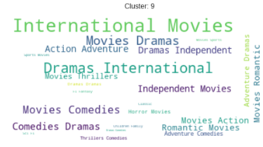
Cluster 5: Science, Nature, Reality, Crime Tv Shows and Docuseries.
Cluster 6: International Movies.
Cluster 7: Anime Series and Tv Shows.
Cluster 8: International Tv Shows.
Cluster 9: Action, Adventure and Independent Movies.

Slide 23
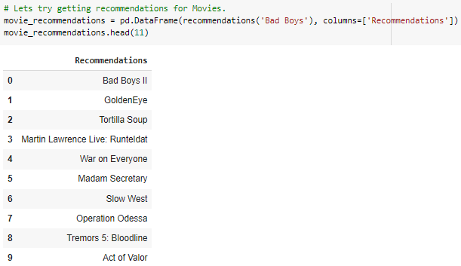
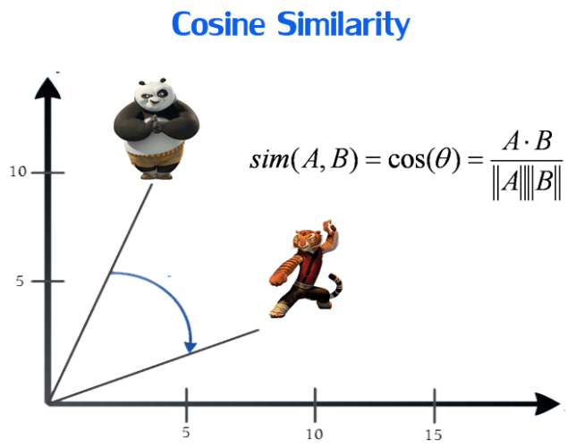
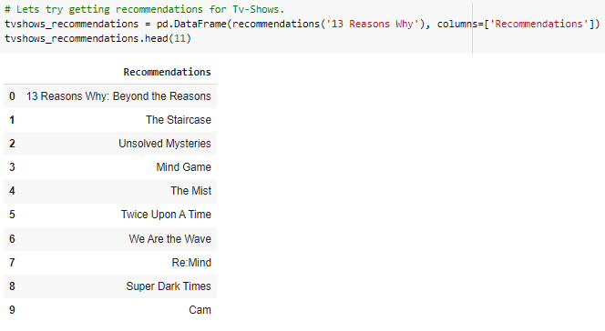
Getting Recommendations
We obtained recommendations for Movies and TV-shows using Cosine similarity.

Slide 24
Conclusions
Its interesting to find out that major content available on NETFLIX is movies.
Now we can see the trend changing and NETFLIX is increasing TV shows number.
United States and India are among the top 5 countries that produce all of the available content on the platform.
NETFLIX releases most of the content on the ending and beginning of the month.
Most of actors in the list of top 10 actors are INDIANS.
Majority of content in TV-MA on NETFLIX that shows mature content is more popular on NETFLIX.
k=10 was found to be an optimal value for clusters using which we grouped our data into 10 distinct clusters.
Using the given data a simple recommender system was created using cosine_similarity and recommendations for Movies and Tv Shows were obtained..

Slide 25
Future Scope
Improve the recommendation system by using new techniques and to increasing viewers on NETFLIX.
Integrating this dataset with other external datasets such as IMDB ratings, rotten tomatoes can also provide many interesting findings.

Slide 26
Thank
You
SIGNING OFF…..

